Slide 1

Unit 3

Slide 2


To learn to describe and compare two of your friends.
To learn to write a passage describing people.

Slide 3


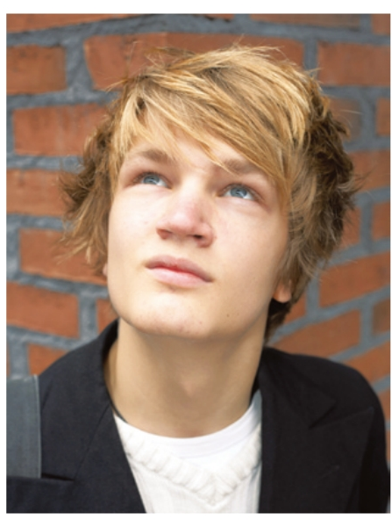
Look at the photos. Talk about the three students’ view on friends.
Jeff Green is quieter than most kids. He likes reading and studies harder in class. He’s shy so it’s not easy for him to make friends. He thinks friends are like books — you don’t need a lot of them as long as they’re good. His best friend Yuan Li is quiet, too. They enjoy studying together.
Jeff Green

Slide 4
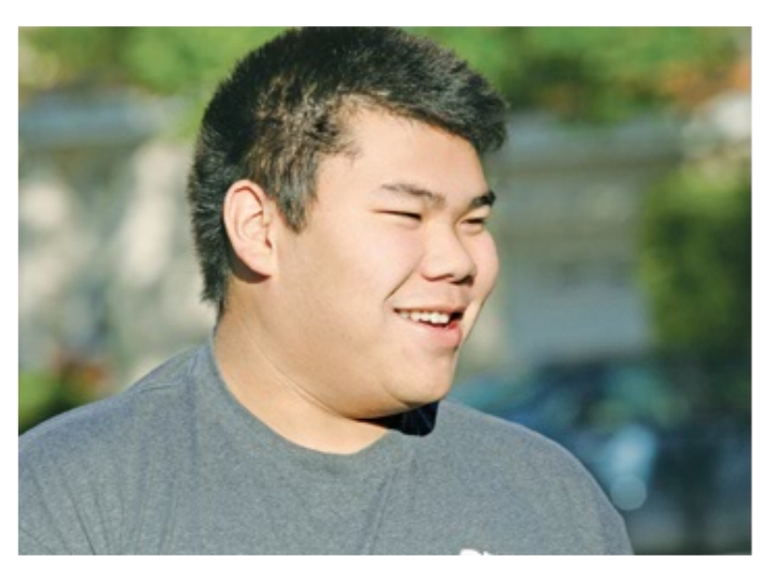
Huang Lei is quite different from his best friend, Larry. Larry is taller and more outgoing than him. Larry is less
hard-working than Huang Lei. They both like sports, but Larry plays tennis better, so he always wins. Larry often says, “My best friend helps to bring out the best in me.”
Huang Lei

Slide 5
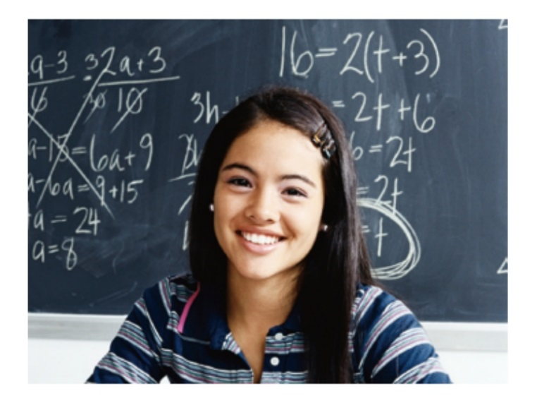
Mary Smith’s favorite saying is, “A true friend reaches for your hand and touches your heart.” Her best friend Carol is really kind and very funny. In fact, she’s funnier than anyone Mary knows. Mary broke her arm last year but Carol made her laugh and feel better. They can talk about and share everything.
Mary Smith

Slide 6


Look at the chart below about Wang Lingling and Liu Lili.
They are best friends. Try to compare(比较) them.
Wang Lingling | Liu Lili
1 tall | tall
2long straight hair | short straight hair
3 likes reading | likes sports
4 popular | popular
5 outgoing | outgoing
6 serious | funny
7 hard-working | smart
Wang Lingling’s best friend is Liu Lili. They are both tall, but …
_____________________________________________________________________________________________________
外貌
爱好
性格
=Both of them are tall.
=They both are tall.
行为习惯
(生活、学习态度)

Slide 7


Make notes about two of your friends. One friend should be similar to you; the other friend should be different.
A friend who is similar to me | A friend who is different from me
Name: | Name:
tall and thin
funny and popular
likes reading
is good at sports
quiet and serious
speaks loudly
hard-working
smart
has good grades
a good listener

Slide 8


Read the job ad(advertisement广告). Then compare two of your classmates. Decide which classmate is better for the job.

Slide 9
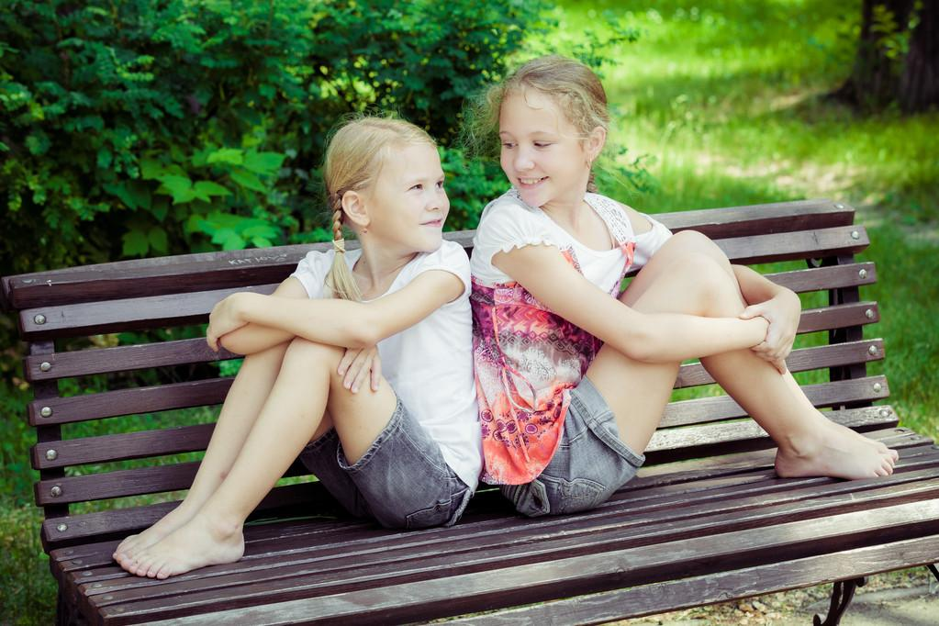
Unit 3
I’m more outgoing than my sister.

Slide 10



Slide 11
Writing

Slide 12
Wang Lingling’s best friend is Liu Lili.
Wang Lingling | Liu Lili
1 tall | tall
2long straight hair | short straight hair
3 likes reading | likes sports
4 popular | popular
5 outgoing | outgoing
6 serious | funny
7 hard-working | smart
外貌
爱好
性格

Slide 13
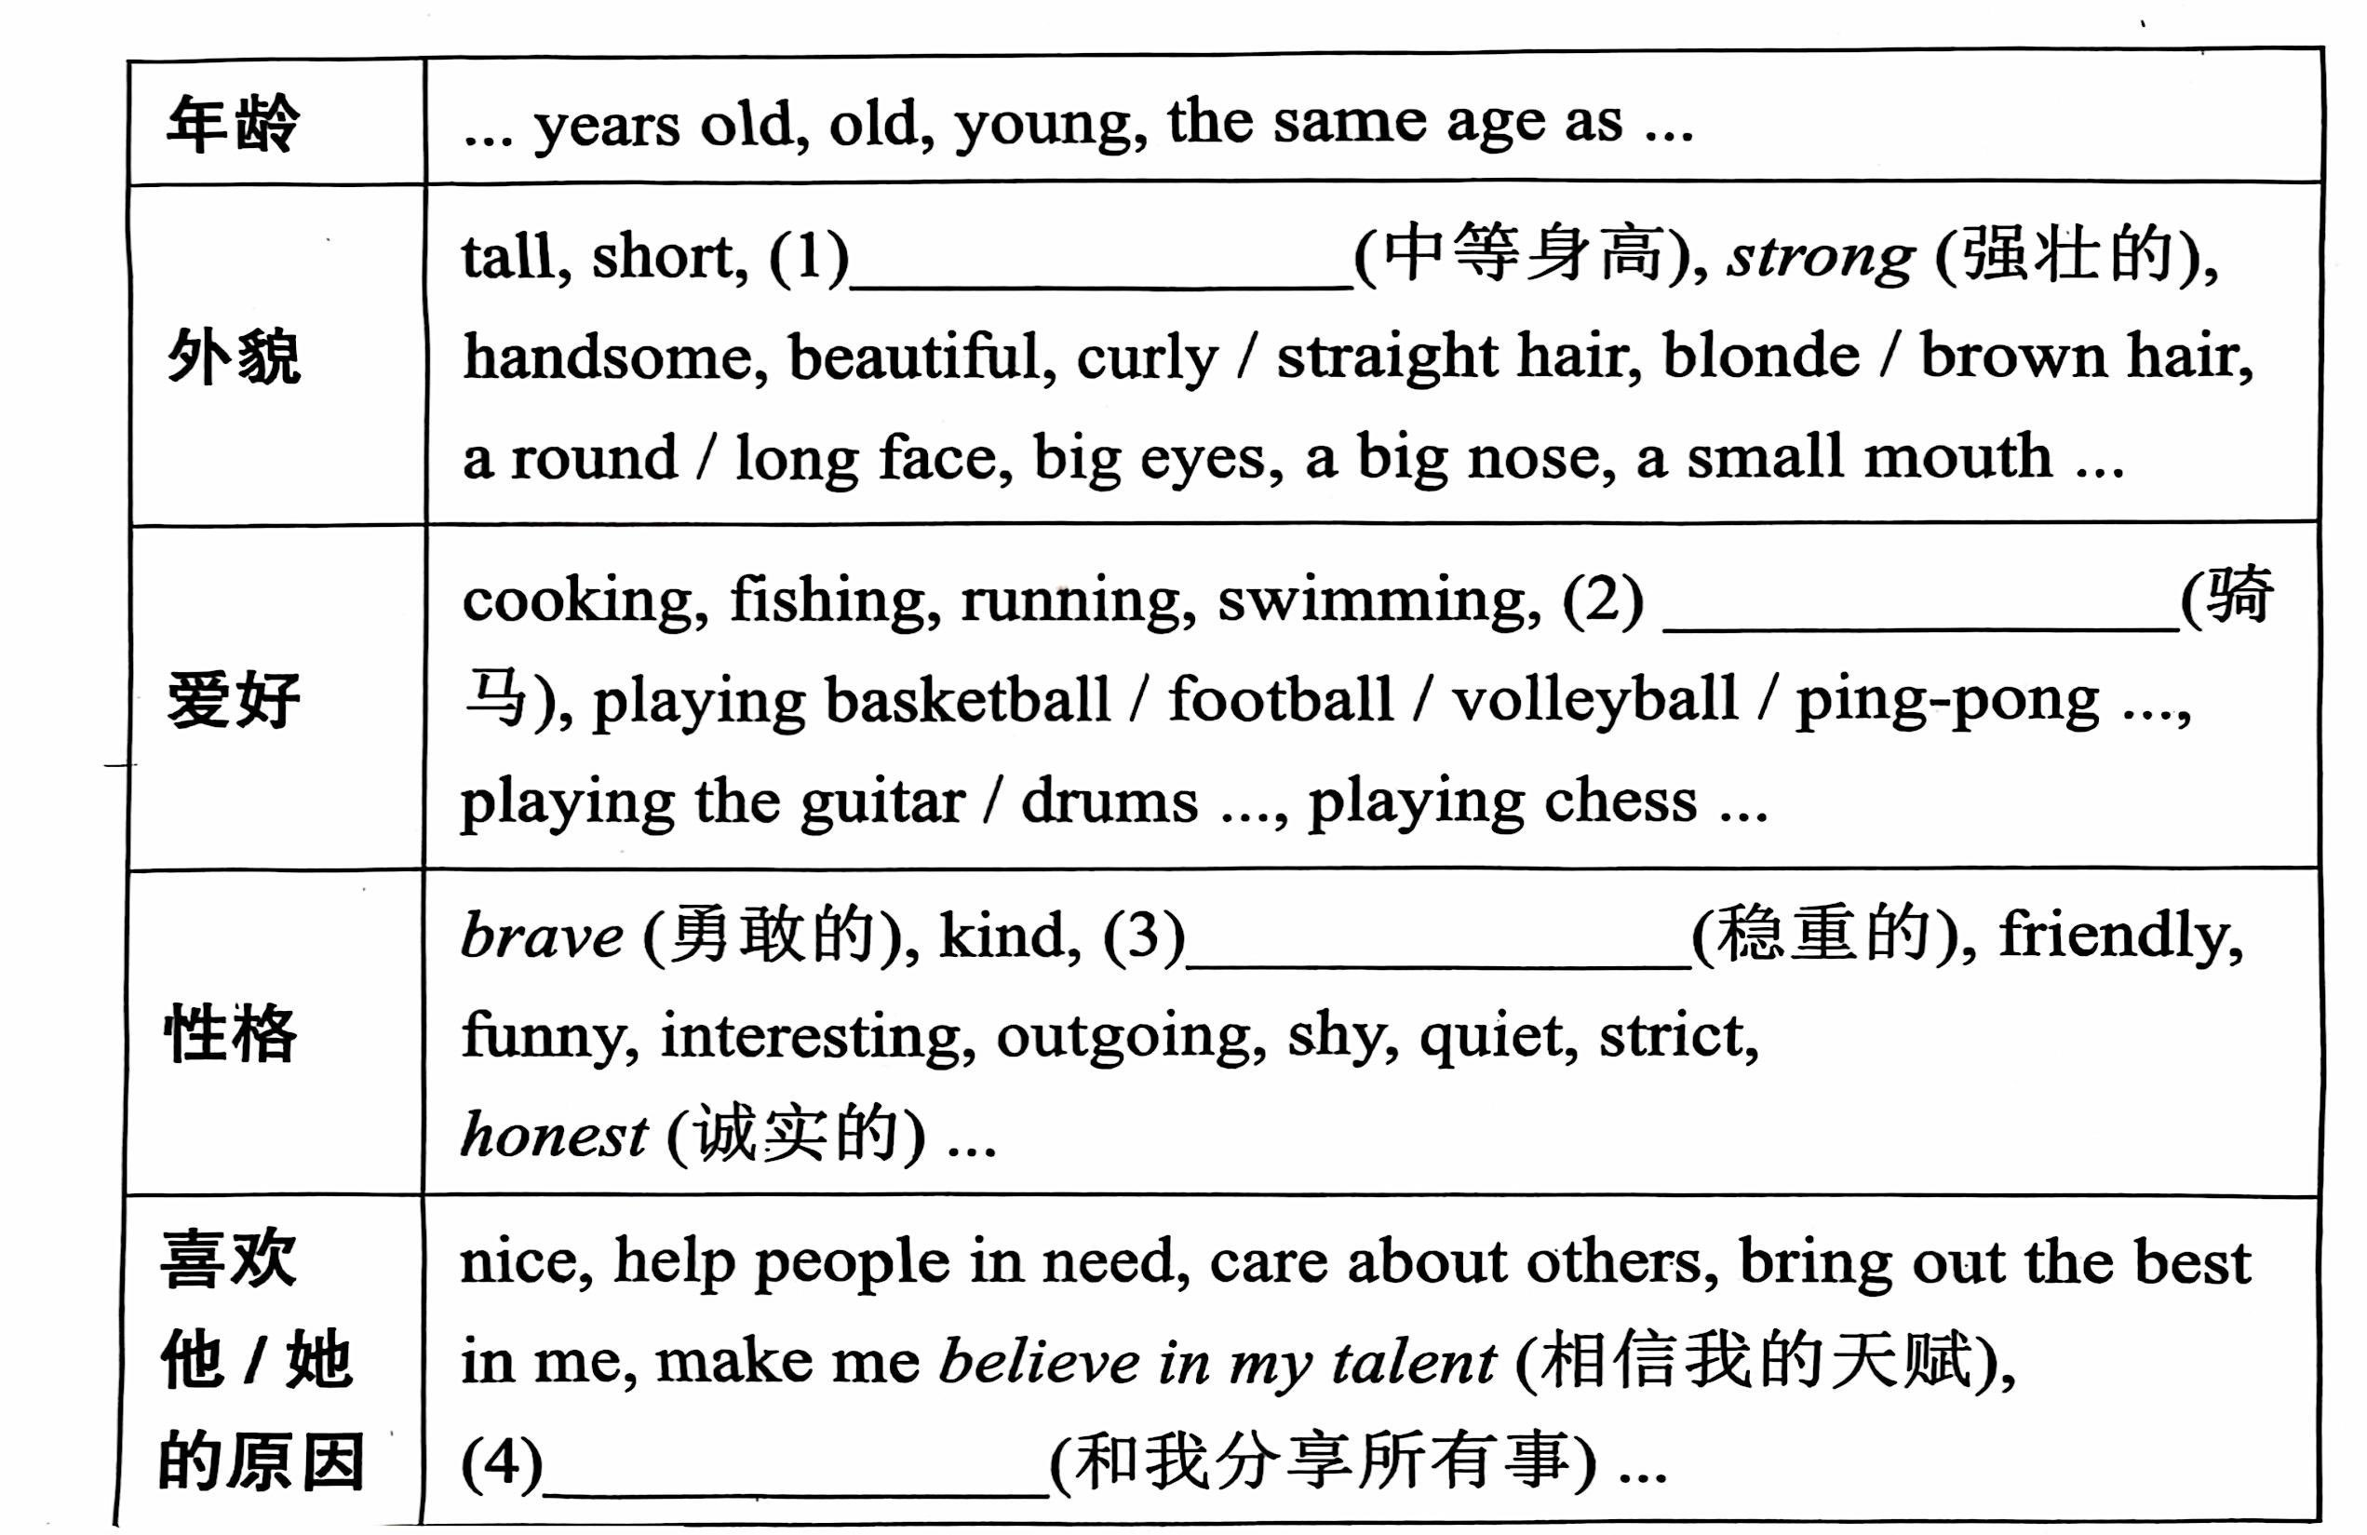
周报
heavy/thin

Slide 14
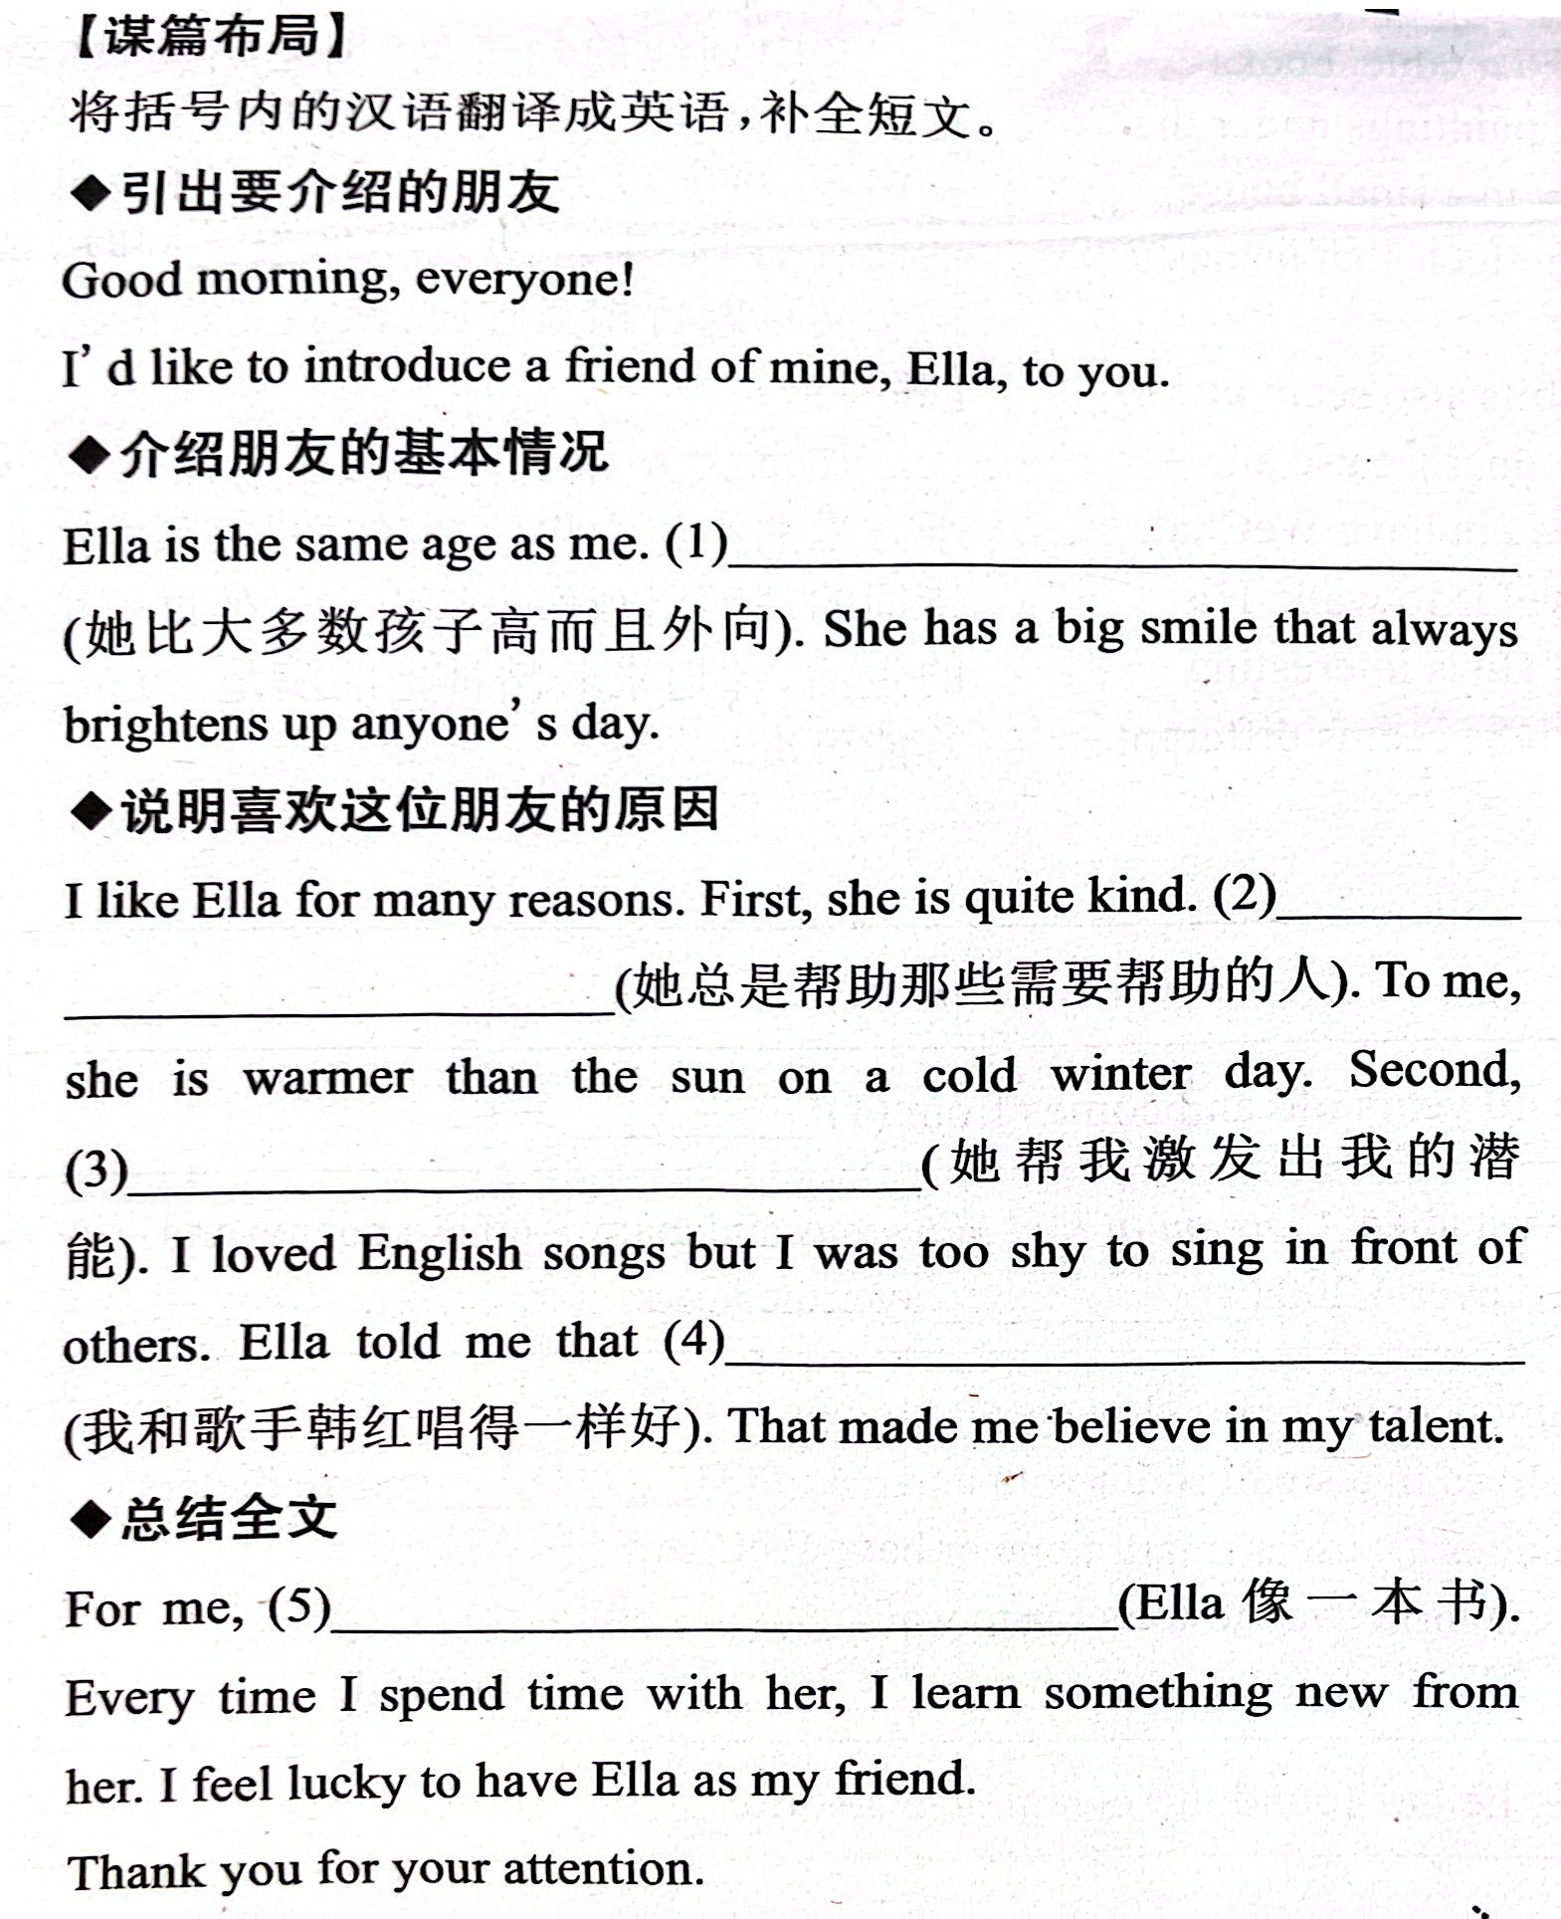
介绍一个朋友。(4段式)

Slide 15
对比两个朋友. (引入话题——基本情况)
Wang Lingling’s best friend is Liu Lili. They are both tall.
Lingling has long straight hair, but Lili has short straight hair. Lingling likes reading, but Lili likes sports. They are both popular and outgoing. However, Lingling is more serious and hard-working than Lili. Lili is funnier and smarter than Lingling.

Slide 16
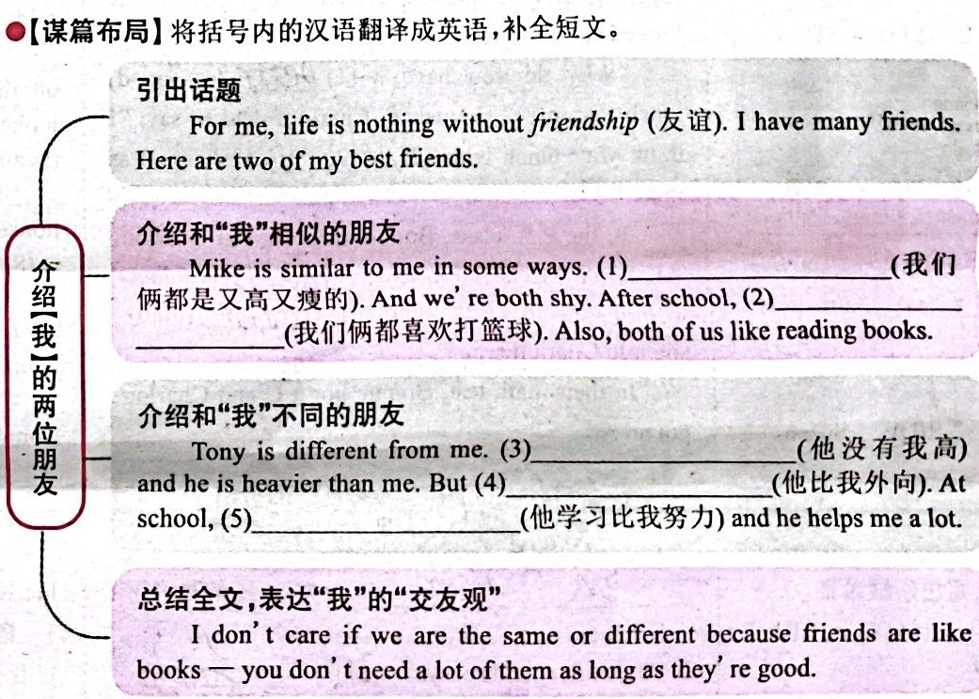
Introduce your two friends. One friend should be similar to you; the other friend should be different.

Slide 17
Read the job ad(advertisement广告).
要素：
招牌职位
具体招聘信息
应聘条件
联系方式

Slide 18


1. Put the words in the correct columns in the chart.
hard-working, run fast, quiet,
serious, jump high, smart
What people are like | What people can do
hard-working
run fast
serious
smart
quiet
jump high

Slide 19
2. Fill in the blanks using the correct forms of the words in brackets.
1. My brother is _____________ (funny) than me. He makes people laugh a lot.
2. I’m outgoing, but my best friend is a lot _____________ (outgoing) than me.
3. My brother is as _____________ (serious) as my sister. They both like to study.
funnier
more outgoing
serious

Slide 20
4. My cousin can run ___________ (fast) than me. She is taller than me, too.
5. Jim is _____________ (friendly) than Tom, so Tom has more friends than Jim.
faster
less friendly

Slide 21
3. Think of your best friend. Write down two ways in which you are similar, and two ways in which you are different. Use comparatives.
My best friend and I are both outgoing.
My best friend and I can run very fast.
My best friend can sing better than me.
My best friend is less hard-working than me.

Slide 23
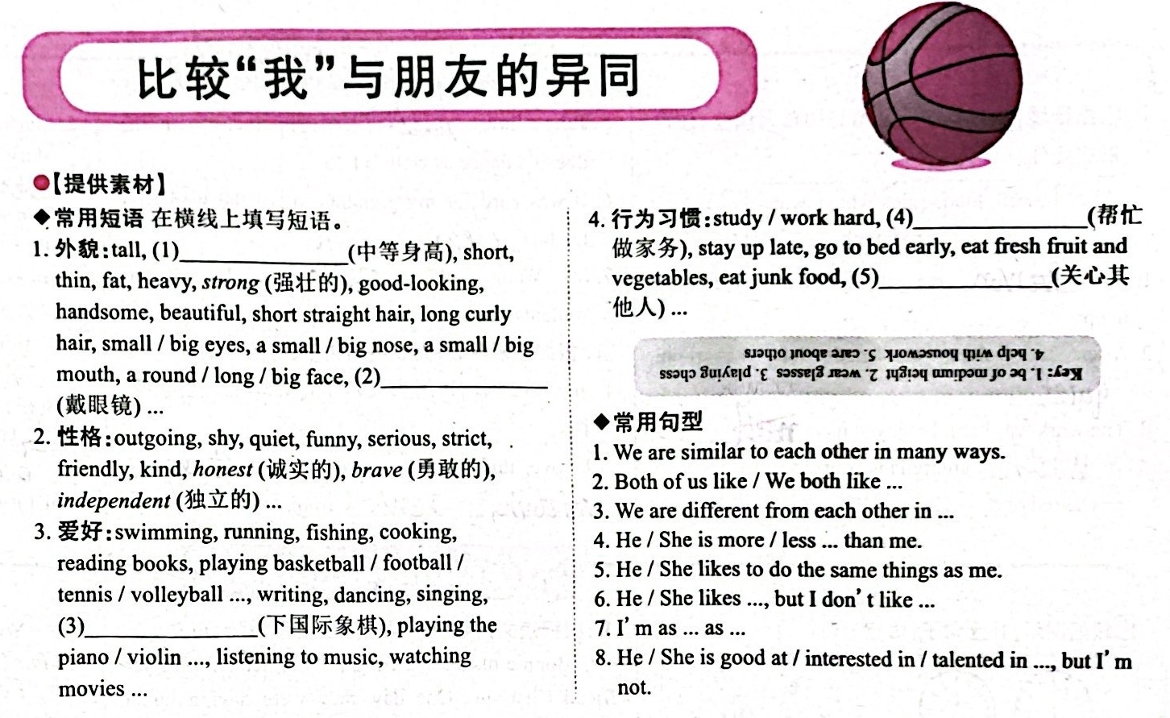
时态：一般现在时。
人称：描述他人时，用第三人称
周报 P4

Slide 24
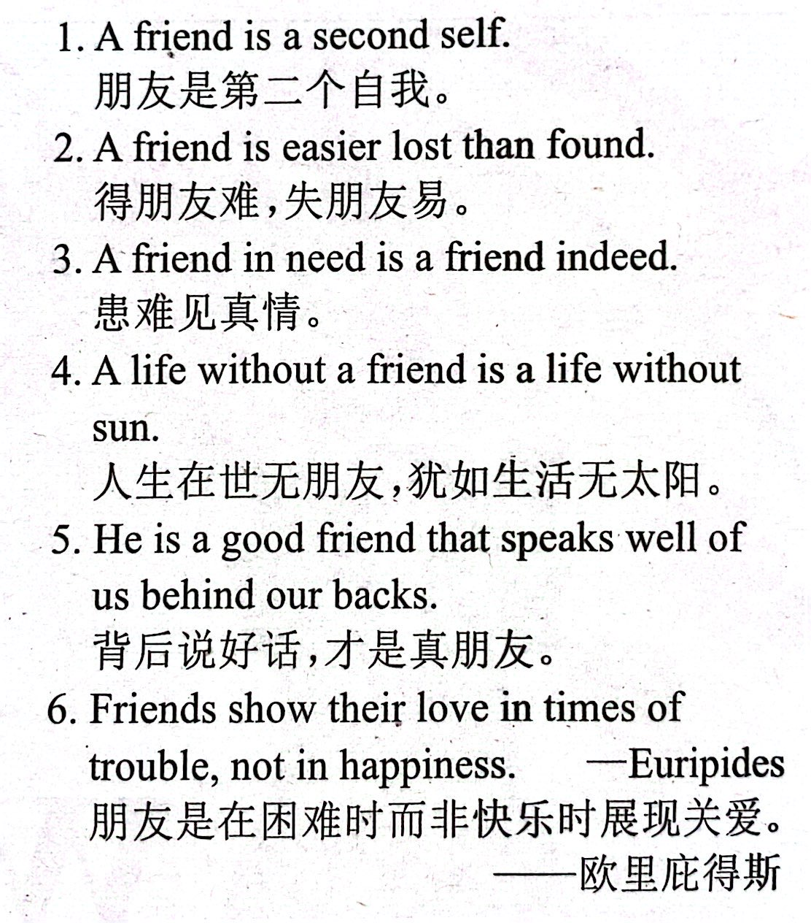
交友观

Slide 25

Write a passage describing your friends.
【审清题目】
内容：介绍你的两位朋友(一位与你相似，一位与你不同)。
文体：描写性质的文体。
时态：描述人物现在的情况，用一般现在时。
人称：描述他人时，用第三人称。

Slide 26

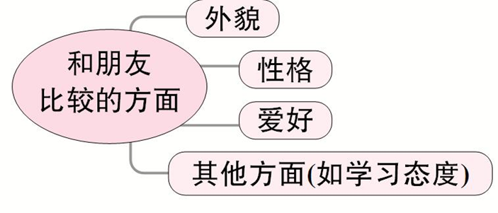
【头脑风暴】

Slide 27
【提供素材】
◆语块
1. 外貌：tall, thin, heavy, strong, of medium height, short straight hair, long curly hair, big eyes, wear glasses
2. 性格：outgoing, shy, quiet, funny, serious, smart, clever, friendly, kind (友好的), honest (诚实的), brave (勇敢的)
3. 爱好：playing basketball / football / tennis / volleyball ..., swimming, reading, writing, dancing, singing, playing chess, playing the piano / violin ..., be interested / talented in
4. 学习态度：hard-working, careful, careless (粗心的)

Slide 28
◆句型
1. We are similar to each other in many ways.
2. Both of us like ...
3. We are different from each other in ...
4. She / He is more / less ... than me.
5. She / He likes to do the same things as me.
6. She / He is / likes ..., but I am not / don’t like ...
7. I’m as ... as ...

Slide 29
◆谚语
Better without gold than without friends.
(宁可没有金钱，不可没有朋友。)
A friend in need is a friend indeed.
Good friends are like stars. You don’t always see them, but you know they’re always there.

Slide 30

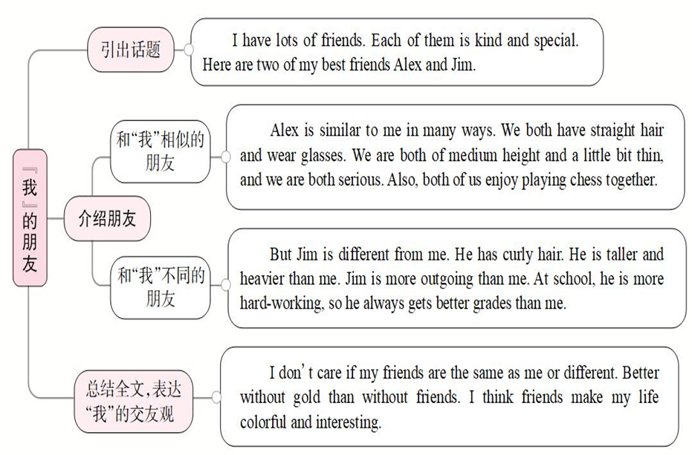

Slide 31


小学
善于应付……的；
对……有办法
一个中学生
有好的英语成绩
primary school
be good with
a middle school student
have good grades in English

Slide 32
Read the job ad and answer the questions.
1. What job is the ad for?
2. What does the English Study Center need the weekend helper for?
3. What kind of person is good for this job?
A weekend student helper for primary school students.
For primary school students.
Have good grades in English; be good with children; be outgoing

Slide 33
Can you add more words or phrases in the chart?
What people are like | What people can do
funny
study harder
outgoing
play the guitar better
friendly
popular
get up earlier
sing more clearly

Slide 34


下列招聘要求，应当需要什么样的性格或爱好的人呢？
have good grades in English →
be good with children →
be outgoing →
smart, clever, hard-working
friendly, kind, funny, like playing games
like to talk, like sports

Slide 35

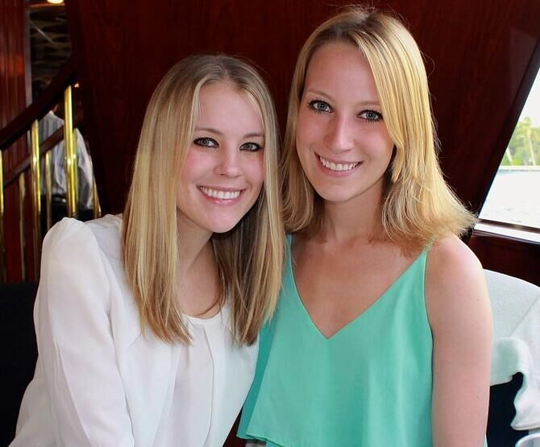
Compare two of your classmates.
A: So who do you think should get the job, … or …?
B: Well, …is smarter. I think she should get the job.
A: … is smarter, but I think … is more outgoing.

Slide 36


Ⅰ. 根据句意及括号内所给单词的提示填空。
1. Julia says she is feeling a lot ____________ (well) today.
2. Our new schoolbags look similar, but yours is much __________________________ (expensive) than mine.
3. My father says I don't write as _______________ (carefully) as I did last term.
better
more expensive/less expensive
carefully

Slide 37
4. Mary is _____________________ (friendly) than me, and she is always there to help others, so she is ______________ (popular) at school.
5. My father is getting a little ____________ (fat) than he was five years ago.
more friendly/friendlier
more popular
fatter

Slide 38
Ⅱ.根据短文内容，从方框中选择恰当的单词填空，注意形式变化。
well, fact, decide, saying, serious, care, true, touch, hard-working, different
Amazing China (《厉害了，我的国》) is a 90-minute documentary (纪录片) about the development (发展) of China. It tells us how the (1)___________ Chinese people work together and make our dream come true. Many students go to the cinema to see it, though it is a (2)______ movie, not a funny one.
hard-working
serious

Slide 39
well, fact, decide, saying, serious, care, true, touch, hard-working, different
These days young men really (3)______ about our country. I think it’s (4)______ necessary for all the students to watch the movie because it helps them to know China (5)______. I asked some students who had seen the movie how they liked it. Here are their answers.
Li Zhenyu, 14, from Xi’an, said, “It was a great movie. The stories in the movie (6)________ my heart.
care
truly
better
touched

Slide 40
well, fact, decide, saying, serious, care, true, touch, hard-working, different
From then on, I (7)__________ to work harder than before.”
Zhang Cheng, 15, from Beijing, said, “The movie shows that China progressed (进步) quickly in (8)__________ ways. I’m proud (骄傲的) to be Chinese.”
Song Qingqing, 18, from Shanghai, said, “I remembered an old (9)______: Where there is a will, there is a way. In (10)______, I’m sure we Chinese people all work hard to make China a greater country in the future.”
decided
different
saying
fact

Slide 41


Think of your best friend. Write down two ways in which you are similar, and two ways in which you are different.

Slide 42


